Slide 1

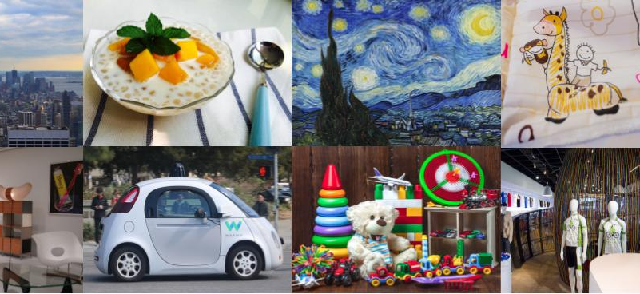
Google Universal Image Embedding Challenge
EEE511(Fall 22,Team#9): Sumant Kulkarni, Dhanraj Bhosale, Pratyush Pandey, Shayal Shamsu
Hosted by Kaggle in collaboration with Google Research and Google Lens.
Developed models are expected to retrieve relevant database images for a given query image
Challenge is to build a single universal image embedding model capable of representing objects from multiple domains at the instance level.
Image dataset comprises a variety of object types - Apparel, Artwork, Landmarks, Furniture, & Packaged Goods, among others.

Slide 2
Motivation: A challenging computer vision problem is Instance-Level Recognition (ILR) where the task is to not only determine the generic category of an object (e.g., an arch) but also the specific instance of the object (e.g., ”India Gate, Delhi”).
Significance: ILR is tackled by training a deep learning model with a large set of images. capturing all of object domain in a single dataset and training a model that can distinguish between them is a challenging task. The focus of research so far has been to solve ILR for a single domain at a time. The next step is to generalize the ILR task to multiple domains.
Impact: Google research believes that this is the key to real-world visual search applications, such as augmenting cultural exhibits in a museum, organizing photo collections, visual commerce and more.

Slide 3
References
Google AI Blog - Introducing the Google Universal Image Embedding Challenge, August 4, 2022, Posted by Bingyi Cao, Software Engineer, Google Research, and Mário Lipovský, Software Engineer, Google Lens, https://ai.googleblog.com/2022/08/introducing-google-universal-image.html
Google Universal Image Embedding Kaggle Competition - https://www.kaggle.com/competitions/google-universal-image-embedding/overview
Public datasets for domain specific images representation
Imagenet - https://www.image-net.org/index.php (Available for free to researchers for non-commercial use)
Products -10K - https://products-10k.github.io/ (Available for free for non-commercial research and educational purposes)
Google Landmark Recognition 2021 - https://www.kaggle.com/competitions/landmark-recognition-2021/data (Dataset is part of Kaggle competition in 2021)
Justification
Many public datasets are available for training the model. Some of them are mentioned in the references above
Some scaled down versions of these datasets are also available on Kaggle and other locations
The host of the competition, Google research is well known expert in the field of image representation
Google has provided starter code for both PyTorch and Tensorflow models as part of the data description
Code: https://www.kaggle.com/code/motono0223/guie-clip-tensorflow-train-example
System Requirement: Quad core Intel Core i7, 16 GB Ram, 256 SSD, Premium graphics cards like GTX 980
Kaggle Notebook and computing resources will be available for training the model.

